Slide 1


Describing Data: Centre, Spread and Shape
05
PART I · FOUNDATIONS OF DATA
CHAPTER 5 · WEEK 3
Data Science — From Foundations to Intelligent Systems
LECTURER
Dr. Mustafa Hameed
THE ISLAMIA UNIVERSITY OF BAHAWALPUR
Bahawalpur, Pakistan
Department of Information Technology · BSIT · Fall 2026
Notes:
Chapter 5: Describing Data: Centre, Spread and Shape. Part 1 — Foundations of Data. Week 3: Describing data; probability. Handout pages 29–34.

Slide 2

Where this chapter sits
THE COURSE
PART I
PART II
PART III
PART IV
PART V
PART VI
1
2
3
4
5
6
7
8
9
10
11
12
13
14
15
16
17
18
19
20
21
22
23
24
25
26
27
28
29
30
31
32
Describing Data: Centre, Spread and Shape
BUILDS ON
USED LATER IN
Ch 3 Data: Types, Sources and Quality
Ch 6 Probability and Uncertainty
Ch 4 The Mathematical Toolkit
Ch 8 Exploratory Data Analysis and Visualisation
Ch 9 Inferential Statistics
Ch 11 Machine Learning Fundamentals
Ch 19 Sequences, Time Series and Streaming Analytics
Data Science · Chapter 5 · Describing Data: Centre, Spread and Shape
Handout p. 29 2
Notes:
Place the chapter. Before you start: Chapter 3 (measurement scales — they decide which summary is legal) and Chapter 4 (summation notation).

Slide 3

What you will be able to do
LEARNING OUTCOMES
By the end of this chapter you will be able to:
1
Compute and choose between the mean, median and mode for a given variable.
2
Compute range, variance, standard deviation and the interquartile range, and say what each is robust to.
3
Read a boxplot and identify outliers by the 1.5 × IQR rule.
4
Recognise skew from a histogram and predict how it displaces the mean relative to the median.
5
Identify which common distribution a variable plausibly follows and why that matters.
Data Science · Chapter 5 · Describing Data: Centre, Spread and Shape
Handout p. 29 3
Notes:
Read these out: they are the chapter's contract with the room. Each click adds one.

Slide 4

Vocabulary for this chapter
KEY TERMS
mean
median
mode
range
variance
standard deviation
quartile
interquartile range
outlier
skewness
normal, uniform, binomial, Poisson and long-tailed distributions
robustness
Each term is defined where it first matters — not here.
Data Science · Chapter 5 · Describing Data: Centre, Spread and Shape
Handout p. 29 4
Notes:
Do not define these now; they arrive one at a time. This slide is for the students' notes. Terms: mean; median; mode; range; variance; standard deviation; quartile; interquartile range; outlier; skewness; normal, uniform, binomial, Poisson and long-tailed distributions; robustness.

Slide 5

In this chapter
IN THIS CHAPTER
5.1
Why Summarise at All
p. 29 ›
5.2
Measures of Centre
p. 29 ›
5.3
Measures of Spread
p. 30 ›
5.4
Shape: Skew and the Distributions You Will Meet
p. 31 ›
Data Science · Chapter 5 · Describing Data: Centre, Spread and Shape
Handout pp. 29–34 5
Notes:
The route through the chapter. Each row is a link: click it to jump to that section in the slide show.

Slide 6

Why Summarise at All
KEY IDEA
You cannot look at 400,000 rows. A summary replaces a dataset with a handful of numbers that preserve what matters and discard what does not — and the entire skill lies in knowing which is which. Every summary is a deliberate loss of information.
Data Science · Chapter 5 · Describing Data: Centre, Spread and Shape
§5.1 · Handout p. 29 6
Notes:
Say this in your own words first; the slide is the handout's wording.

Slide 7
Measures of Centre
SECTION 2 OF 4
5.2
5.1 Why Summarise at All
5.2 Measures of Centre
5.3 Measures of Spread
5.4 Shape: Skew and the Distributions You Will Meet
Data Science · Chapter 5
Handout §5.2 7
Notes:
Pause. Name the question this section answers.

Slide 8

Mean, Median, Mode
DEFINITION
The median is the middle value when the data is sorted (the average of the two middle values if n is even).
The mode is the most frequently occurring value — the only centre that is meaningful for nominal data.
Data Science · Chapter 5 · Describing Data: Centre, Spread and Shape
§5.2 · Handout p. 29 8
Notes:
Read the box aloud, then ask for an example from the room before moving on.

Slide 9

When the Mean Lies
WORKED EXAMPLE
Response times in milliseconds for seven API calls: 12, 14, 15, 15, 17, 19, 8400
Mean: (12+14+15+15+17+19+8400)/7 = 8492/7 ≈ 1213 ms.
Median: sorted, the 4th of 7 values is 15 ms.
Mode: 15 ms.
Interpretation. The mean of 1213 ms describes not a single one of the seven calls. Six were under 20 ms; one timed out. Reporting “average response time is 1.2 seconds” would be technically correct and completely misleading.
The rule this illustrates: the mean is sensitive to extreme values, the median is robust to them. Report the median for anything with a long tail — response times, salaries, session durations, file sizes — which in practice is most operational data you will ever meet.
Data Science · Chapter 5 · Describing Data: Centre, Spread and Shape
§5.2 · Handout p. 29 9
Notes:
Each click adds one step of the working. Ask for the next number before you reveal it.

Slide 10

Measures of Centre
AT A GLANCE
Measure | Valid for | Robust to outliers? | Use when
Mean | Interval, ratio | No — one value can move it arbitrarily | Data is roughly symmetric and you need to do further arithmetic
Median | Ordinal, interval, ratio | Yes — unaffected by how extreme the extremes are | Data is skewed, or outliers are present and genuine
Mode | Any, including nominal | Yes | The variable is categorical, or you want the most typical case
Data Science · Chapter 5 · Describing Data: Centre, Spread and Shape
§5.2 · Handout p. 29 10
Notes:
Do not read the table row by row: pick the row the room is most likely to get wrong and ask why.

Slide 11
Measures of Spread
SECTION 3 OF 4
5.3
5.1 Why Summarise at All
5.2 Measures of Centre
5.3 Measures of Spread
5.4 Shape: Skew and the Distributions You Will Meet
Data Science · Chapter 5
Handout §5.3 11
Notes:
Pause. Name the question this section answers.

Slide 12
Variance and Standard Deviation
DEFINITION
The sample variance is
and the standard deviation is s = √(s²). The standard deviation is the more useful of the two because it is expressed in the same units as the data.
Data Science · Chapter 5 · Describing Data: Centre, Spread and Shape
§5.3 · Handout p. 30 12
Notes:
Two datasets can share a mean and be nothing alike. Spread is what distinguishes “every server responds in about 40 ms” from “servers respond in 5 ms or 200 ms depending on the day”.

Slide 13

Why Divide by n−1?
CONCEPT
Because x̄ was itself estimated from the same data, the deviations are very slightly too small on average. Dividing by n−1 rather than n corrects the bias. For large n the difference is negligible; for the small samples you will meet in project management data it is not.
Data Science · Chapter 5 · Describing Data: Centre, Spread and Shape
§5.3 · Handout p. 30 13
Notes:
Read the box aloud, then ask for an example from the room before moving on.

Slide 14
Quartiles and the Interquartile Range
DEFINITION
Sort the data. Q1 is the value below which 25% falls, Q2 is the median, Q3 is the value below which 75% falls. The interquartile range is IQR = Q3 − Q1: the width of the middle half of the data. Like the median, it is robust.
Data Science · Chapter 5 · Describing Data: Centre, Spread and Shape
§5.3 · Handout p. 30 14
Notes:
Read the box aloud, then ask for an example from the room before moving on.

Slide 15
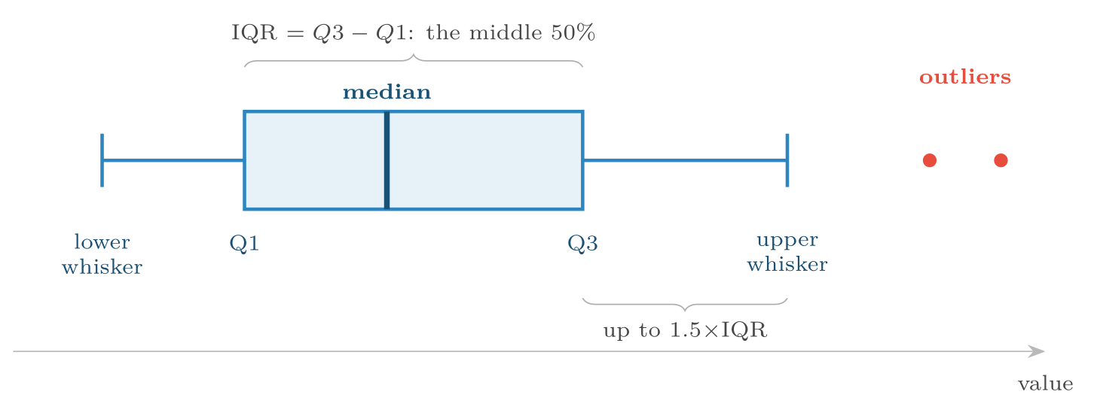
Anatomy of a boxplot
FIGURE 5.1
The box holds the middle 50% of the data, the whiskers reach the furthest point within 1.5×IQR of the box, and anything beyond is drawn individually as a candidate outlier. A boxplot shows centre, spread, skew and outliers in one object.
Data Science · Chapter 5 · Describing Data: Centre, Spread and Shape
§5.3 · Handout p. 30 15
Notes:
Figure 5.1 (handout p. 31): Anatomy of a boxplot. The box holds the middle 50% of the data, the whiskers reach the furthest point within 1.5×IQR of the box, and anything beyond is drawn individually as a candidate outlier. A boxplot shows centre, spread, skew and outliers in one object.

Slide 16
The 1.5 × IQR Rule
DEFINITION
A value is flagged as a candidate outlier if it lies below Q1 − 1.5 IQR or above Q3 + 1.5 IQR. “Candidate” is the operative word: the rule identifies unusual values, not wrong ones.
Data Science · Chapter 5 · Describing Data: Centre, Spread and Shape
§5.3 · Handout p. 30 16
Notes:
Read the box aloud, then ask for an example from the room before moving on.

Slide 17
Applying the Outlier Rule
WORKED EXAMPLE
Login durations (minutes) for one account over ten sessions: 4, 5, 6, 6, 7, 8, 9, 11, 14, 96
Q1 (25th percentile) = 6. Q3 (75th percentile) = 11.
IQR = 11 − 6 = 5.
Fences: lower = 6 − 1.5(5) = −1.5; upper = 11 + 1.5(5) = 18.5.
Flagged: 96 only.
And now the part that matters. What you do next depends entirely on domain, not statistics:
• Learning analytics: probably a student who left a tab open. Cap or remove.
• Cybersecurity: a 96-minute session on an account that normally runs 6 minutes is precisely what you are paid to notice. Do not remove it. In Chapter 16 the outlier becomes the target.
Never delete outliers because a rule flagged them. Investigate, decide, and record the decision.
Data Science · Chapter 5 · Describing Data: Centre, Spread and Shape
§5.3 · Handout p. 30 17
Notes:
Each click adds one step of the working. Ask for the next number before you reveal it.

Slide 18
Shape: Skew and the Distributions You Will Meet
SECTION 4 OF 4
5.4
5.1 Why Summarise at All
5.2 Measures of Centre
5.3 Measures of Spread
5.4 Shape: Skew and the Distributions You Will Meet
Data Science · Chapter 5
Handout §5.4 18
Notes:
Pause. Name the question this section answers.

Slide 19
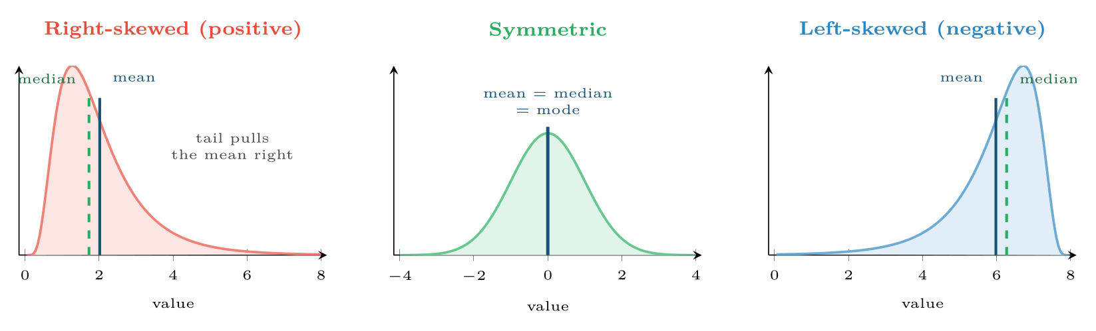
Skew and what it does to the centre
FIGURE 5.2
The mean is dragged towards the long tail; the median stays put. If mean and median differ substantially, the distribution is skewed and you should report the median.
Data Science · Chapter 5 · Describing Data: Centre, Spread and Shape
§5.4 · Handout p. 31 19
Notes:
Figure 5.2 (handout p. 31): Skew and what it does to the centre. The mean is dragged towards the long tail; the median stays put. If mean and median differ substantially, the distribution is skewed and you should report the median.

Slide 20
A Diagnostic You Can Do in Your Head
CONCEPT
Compare the mean and the median. If x̄ ≫ median, the data is right-skewed — there is a long tail of large values. If x̄ ≪ median, it is left-skewed. If they are close, it is roughly symmetric. This one comparison tells you more about a variable than any single number.
Data Science · Chapter 5 · Describing Data: Centre, Spread and Shape
§5.4 · Handout p. 31 20
Notes:
Read the box aloud, then ask for an example from the room before moving on.

Slide 21
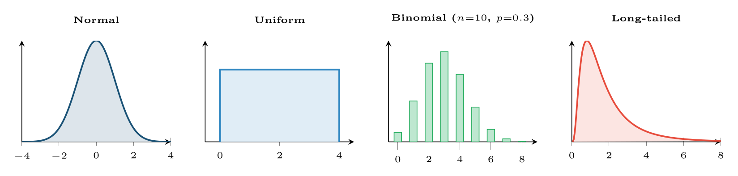
Four shapes you will meet constantly
FIGURE 5.3
Recognising which one a variable follows tells you which summary to report, which model assumptions are safe, and whether “three standard deviations” means anything.
Data Science · Chapter 5 · Describing Data: Centre, Spread and Shape
§5.4.1 · Handout p. 32 21
Notes:
Figure 5.3 (handout p. 32): Four shapes you will meet constantly. Recognising which one a variable follows tells you which summary to report, which model assumptions are safe, and whether “three standard deviations” means anything.

Slide 22
Four Distributions Worth Recognising
AT A GLANCE
Distribution | Arises when | You will meet it as
Normal | Many small independent effects add up | Exam marks, measurement error, sensor noise around a set point
Uniform | Every value equally likely | Random IDs, hash outputs, a well-shuffled sample
Binomial | n independent yes/no trials with fixed probability | Number of quizzes passed out of 10; number of packets dropped out of 1000
Poisson | Counts of rare events in a fixed window | Failed logins per minute; defects per release; sensor faults per day
Long-tailed | Multiplicative effects, “rich get richer” | Response times, file sizes, session lengths, incident cost
Data Science · Chapter 5 · Describing Data: Centre, Spread and Shape
§5.4.1 · Handout p. 32 22
Notes:
Do not read the table row by row: pick the row the room is most likely to get wrong and ask why.

Slide 23

Not Everything Is Normal
WATCH OUT
The normal distribution is the default assumption of a great deal of classical statistics, and a great deal of operational data violates it badly. Response times cannot be negative and have a long right tail; counts of rare security events are Poisson, not normal. Applying a rule like “flag anything beyond three standard deviations” to a long-tailed variable will flag a large fraction of perfectly normal traffic. Chapter 9 returns to when normality can be assumed anyway.
Data Science · Chapter 5 · Describing Data: Centre, Spread and Shape
§5.4.1 · Handout p. 32 23
Notes:
Read the box aloud, then ask for an example from the room before moving on.

Slide 24





Four lenses: Summarising a Variable
FOUR LENSES
LEARNING ANALYTICS
PROJECT MANAGEMENT
Time spent on an assignment is strongly right-skewed: most students take 2–4 hours, a few take thirty.
Task completion times are right-skewed for the same reason: a task can overrun without limit but cannot finish in less than zero.
INTERNET OF THINGS
CYBERSECURITY
Sensor readings around a controlled set point are approximately normal, so the standard deviation is meaningful and a 3σ rule is defensible.
Failed logins per minute per account is a Poisson count, usually with a mode of zero.
Data Science · Chapter 5 · Describing Data: Centre, Spread and Shape
Handout p. 34 24
Notes:
The same method, four domains. Each of the next four slides opens one lens in full.

Slide 25

Learning Analytics: Summarising a Variable
FOUR LENSES
LEARNING ANALYTICS
Project Management
Time spent on an assignment is strongly right-skewed: most students take 2–4 hours, a few take thirty. Report the median hours, not the mean, or every published figure will overstate typical effort and demoralise students who compare themselves to it. The IQR is the honest measure of “how much do students vary”.
Internet of Things
Cybersecurity
Data Science · Chapter 5 · Describing Data: Centre, Spread and Shape
Handout p. 34 25
Notes:
Learning Analytics. Time spent on an assignment is strongly right-skewed: most students take 2–4 hours, a few take thirty. Report the median hours, not the mean, or every published figure will overstate typical effort and demoralise students who compare themselves to it. The IQR is the honest measure of “how much do students vary”.

Slide 26

Project Management: Summarising a Variable
FOUR LENSES
PROJECT MANAGEMENT
Learning Analytics
Task completion times are right-skewed for the same reason: a task can overrun without limit but cannot finish in less than zero. This is why median-based forecasting beats mean-based estimation, and why experienced estimators quote ranges (Q1–Q3) rather than points. A sprint planned on mean velocity will miss more often than it hits.
Internet of Things
Cybersecurity
Data Science · Chapter 5 · Describing Data: Centre, Spread and Shape
Handout p. 34 26
Notes:
Project Management. Task completion times are right-skewed for the same reason: a task can overrun without limit but cannot finish in less than zero. This is why median-based forecasting beats mean-based estimation, and why experienced estimators quote ranges (Q1–Q3) rather than points. A sprint planned on mean velocity will miss more often than it hits.

Slide 27

Internet of Things: Summarising a Variable
FOUR LENSES
INTERNET OF THINGS
Learning Analytics
Sensor readings around a controlled set point are approximately normal, so the standard deviation is meaningful and a 3σ rule is defensible. Battery life and time-between-failures are long-tailed, so it is not. The same fleet therefore needs different summaries for different channels — do not apply one rule across the telemetry.
Project Management
Cybersecurity
Data Science · Chapter 5 · Describing Data: Centre, Spread and Shape
Handout p. 34 27
Notes:
Internet of Things. Sensor readings around a controlled set point are approximately normal, so the standard deviation is meaningful and a 3σ rule is defensible. Battery life and time-between-failures are long-tailed, so it is not. The same fleet therefore needs different summaries for different channels — do not apply one rule across the telemetry.

Slide 28

Cybersecurity: Summarising a Variable
FOUR LENSES
CYBERSECURITY
Learning Analytics
Failed logins per minute per account is a Poisson count, usually with a mode of zero. The mean is a poor description and the standard deviation is nearly meaningless. What matters is the tail: the 99.9th percentile, and how far above it a given account sits. Note also that the outlier you would delete in the learning-analytics lens is the alert you would escalate here.
Project Management
Internet of Things
Data Science · Chapter 5 · Describing Data: Centre, Spread and Shape
Handout p. 34 28
Notes:
Cybersecurity. Failed logins per minute per account is a Poisson count, usually with a mode of zero. The mean is a poor description and the standard deviation is nearly meaningless. What matters is the tail: the 99.9th percentile, and how far above it a given account sits. Note also that the outlier you would delete in the learning-analytics lens is the alert you would escalate here.

Slide 29

Try it yourself: Centre, Spread and Shape in Eight Lines
TRY IT YOURSELF
THIS WEEK'S LAB
WHAT YOU WILL RUN
Week 3: Centre, spread, shape; base-rate simulation
2 listings, 20 lines of Python, R
Data Science · Chapter 5 · Describing Data: Centre, Spread and Shape
§5.4.1 · Handout p. 32 29
Notes:
Say what the room will have at the end of the lab, then let them start. Circulate rather than lecture.

Slide 30
Centre, Spread and Shape in Eight Lines
LAB · STEP 1 OF 1 · LISTING 1
Set-up
Python
1
2
3
4
5
6
7
8
9
10
11
12
13
14
15
16
import numpy as np, pandas as pd
rt = pd.Series([12, 14, 15, 15, 17, 19, 8400]) # response times (ms)
print("mean :", rt.mean()) # 1213.1 <- describes nothing
print("median :", rt.median()) # 15.0 <- describes six of seven
print("std :", rt.std()) # huge, and equally misleading
print("IQR :", rt.quantile(.75) - rt.quantile(.25))
q1, q3 = rt.quantile(.25), rt.quantile(.75)
iqr = q3 - q1
outliers = rt[(rt < q1 - 1.5*iqr) | (rt > q3 + 1.5*iqr)]
print("flagged:", list(outliers))
# The skew diagnostic you can do in your head:
print("mean >> median ?", rt.mean() > 2 * rt.median()) # True => right-skewed
Data Science · Chapter 5 · Describing Data: Centre, Spread and Shape
§5.4.1 · Handout p. 32 30
Notes:
Step 1: Set-up. Read the code aloud; ask what each line would print before running it.

Slide 31
Centre, Spread and Shape in Eight Lines
LAB · STEP 1 OF 1 · LISTING 2
Set-up
R
1
2
3
4
rt <- c(12, 14, 15, 15, 17, 19, 8400)
summary(rt) # min, Q1, median, mean, Q3, max in one call
IQR(rt)
boxplot(rt, horizontal = TRUE)
Data Science · Chapter 5 · Describing Data: Centre, Spread and Shape
§5.4.1 · Handout p. 32 31
Notes:
Step 1: Set-up. Read the code aloud; ask what each line would print before running it.

Slide 32
What the lab shows
TRY IT YOURSELF
R equivalent (the repo’s existing Quarto labs use this style):
Data Science · Chapter 5 · Describing Data: Centre, Spread and Shape
§5.4.1 · Handout p. 32 32
Notes:
Read the box aloud, then ask for an example from the room before moving on.

Slide 33

A variable has mean 45 and median 12. What shape is it, and which figure would you publish?
CHECKPOINT 1 OF 3
Discuss with the person next to you, then advance.
Data Science · Chapter 5 · Describing Data: Centre, Spread and Shape
Handout p. 34 · answers in Appendix D 33
Notes:
Ask the room. Do not advance until someone commits to an answer.

Slide 34

A variable has mean 45 and median 12. What shape is it, and which figure would you publish?
CHECKPOINT 1 OF 3 · ANSWER
Strongly right-skewed. Publish the median of 12, with the IQR; the mean of 45 describes almost none of the observations.
Data Science · Chapter 5 · Describing Data: Centre, Spread and Shape
Handout p. 34 · answers in Appendix D 34
Notes:
Answer (Appendix D): Strongly right-skewed. Publish the median of 12, with the IQR; the mean of 45 describes almost none of the observations.

Slide 35
For the data 2, 4, 4, 5, 9: compute the mean, the median and the sample standard deviation.
CHECKPOINT 2 OF 3
Discuss with the person next to you, then advance.
Data Science · Chapter 5 · Describing Data: Centre, Spread and Shape
Handout p. 34 · answers in Appendix D 35
Notes:
Ask the room. Do not advance until someone commits to an answer.

Slide 36
For the data 2, 4, 4, 5, 9: compute the mean, the median and the sample standard deviation.
CHECKPOINT 2 OF 3 · ANSWER
Mean = 24/5 = 4.8. Median = 4. s² = ((2−4.8)²+(4−4.8)²+(4−4.8)²+(5−4.8)²+(9−4.8)²)/4 = (7.84+0.64+0.64+0.04+17.64)/4 = 6.7, so s ≈ 2.59.
Data Science · Chapter 5 · Describing Data: Centre, Spread and Shape
Handout p. 34 · answers in Appendix D 36
Notes:
Answer (Appendix D): Mean = 24/5 = 4.8. Median = 4. s2 = ((2−4.8)2+(4−4.8)2+(4−4.8)2+(5−4.8)2+(9−4.8)2)/4 = (7.84+0.64+0.64+0.04+17.64)/4 = 6.7, so s ≈ 2.59.

Slide 37
Why is the mode the only measure of centre available for the variable protocol ∈ {TCP, UDP, ICMP}?
CHECKPOINT 3 OF 3
Discuss with the person next to you, then advance.
Data Science · Chapter 5 · Describing Data: Centre, Spread and Shape
Handout p. 34 · answers in Appendix D 37
Notes:
Ask the room. Do not advance until someone commits to an answer.

Slide 38
Why is the mode the only measure of centre available for the variable protocol ∈ {TCP, UDP, ICMP}?
CHECKPOINT 3 OF 3 · ANSWER
Because the values are unordered category labels. “Average protocol” has no meaning, and a median requires an ordering that does not exist. Only the most frequent value is defined.
Data Science · Chapter 5 · Describing Data: Centre, Spread and Shape
Handout p. 34 · answers in Appendix D 38
Notes:
Answer (Appendix D): Because the values are unordered category labels. “Average protocol” has no meaning, and a median requires an ordering that does not exist. Only the most frequent value is defined.

Slide 39

What to take away
CHAPTER SUMMARY
1
The mean is sensitive to extremes; the median and IQR are robust. Skewed data should be summarised by the median.
2
Standard deviation is variance in the original units, which is why it is the one usually reported.
3
The 1.5×IQR rule identifies candidate outliers. Whether to remove them is a domain decision, never a statistical one — in security they are the target.
4
Comparing mean with median is a free, instant diagnostic of skew.
5
Normal, uniform, binomial, Poisson and long-tailed shapes each imply different valid summaries. Assuming normality by default is a common and costly error.
Data Science · Chapter 5 · Describing Data: Centre, Spread and Shape
Handout p. 34 39
Notes:
Ask the room to say each takeaway before you reveal it.

Slide 40

Quick check 1 of 2
REVIEW · MULTIPLE CHOICE
Which measure of centre is unaffected by a single extreme value?
A
Mean
B
Median
C
Variance
D
Standard deviation
Data Science · Chapter 5 · Describing Data: Centre, Spread and Shape
Handout p. 34 40
Notes:
Take a show of hands for each option before discussing. (The handout does not print MCQ answers.)

Slide 41
Quick check 2 of 2
REVIEW · MULTIPLE CHOICE
If mean > median, the distribution is:
A
left-skewed
B
symmetric
C
right-skewed
D
uniform
Data Science · Chapter 5 · Describing Data: Centre, Spread and Shape
Handout p. 34 41
Notes:
Take a show of hands for each option before discussing. (The handout does not print MCQ answers.)

Slide 42
For your notebook
REVIEW QUESTIONS
SHORT
State the 1.5×IQR rule and explain why its output should be called “candidates” rather than “outliers”.
SHORT
Why is variance divided by n−1 rather than n for a sample?
SHORT
Give one variable from IoT telemetry that is approximately normal and one that is long-tailed, and say how your reporting differs between them.
APPLIED
Session durations (minutes) for one user: 3, 4, 4, 5, 5, 6, 7, 9, 12, 140. Compute Q1, Q3, IQR and the fences; identify flagged values; then argue both for keeping and for removing the 140, naming the domain in which each argument wins.
APPLIED
A dashboard reports “average time on task: 47 minutes” for an online course. Explain what could be wrong with this headline and propose two better numbers to display alongside it.
Data Science · Chapter 5 · Describing Data: Centre, Spread and Shape
Handout p. 34 42
Notes:
Set these for independent study. Model answers are not printed in the handout.

Slide 43
End of Chapter 5
05
NEXT
READ
Chapter 6 — Probability and Uncertainty
Handout Chapter 5, pages 29–34
THIS WEEK'S LAB
ASSESSMENT
Centre, spread, shape; base-rate simulation
Quiz 1 (Ch 1–4)
Data Science · Chapter 5 · Describing Data: Centre, Spread and Shape
43
Notes:
Close. NEXT: Chapter 6 — Probability and Uncertainty. READ: Handout Chapter 5, pages 29–34. THIS WEEK'S LAB: Centre, spread, shape; base-rate simulation. ASSESSMENT: Quiz 1 (Ch 1–4).

